Slide 1
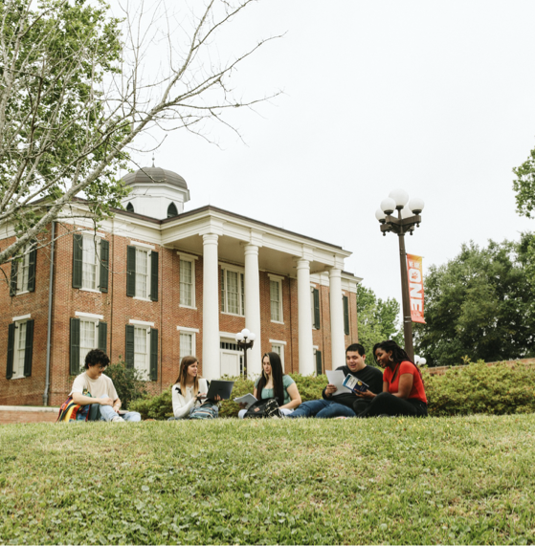




Mentor TEACHER ORIENTATION
Internship

Slide 2
OBJECTIVES
Explore
Understand
Explain
Explore the components of the SHSU Internship Program and stakeholders involved
Understand the roles of the Professor of Practice and Mentor Teacher in coaching the teacher candidate
Explain how data is analyzed to grow intern teachers and the intern teaching program
Explore
Explore the components of the SHSU Clinical Teaching Program and stakeholders involved
Understand
Understand the roles of the site coordinator and cooperating teacher in coaching the teacher candidate
Emphasize
Emphasize the co-teaching approaches and the coaching role to understand how they are used to help teacher candidates progress
Explain
Explain how data is analyzed to grow student teachers and the YCT program

Slide 3
KEY STAKEHOLDERS
The Faculty Member
The Teacher Candidate
Intern Teacher
The School Administrator
The Recruited & Trained Mentor Teacher
The Professor of Practice
University Supervisor

Slide 4
ROLE OF THE MENTOR TEACHER
1
2
3
Work collaboratively with the intern and Professor of Practice and communicate about the intern's process.
Co-plan and model instructional practices for the intern.
Collaborate with the intern to set goals and share feedback about progress.
4
5
Schedule time to plan with the intern, ensuring the intern has time and resources to be successful.
Complete and review forms in TK20 for data collection and communication with the Professor of Practice

Slide 5
EXPECTATIONS
The Mentor Teacher Should
TAC §228.97(b) Duties of a mentor:
(1) guide, assist, and support the candidate throughout the entirety of the internship in areas such as lesson preparation, classroom management, instruction, assessment, working with parents, obtaining materials, and district policies; and
(2) report the candidate's progress to the candidate's field supervisor.
Take opportunities to explain their thinking to build understanding of how teachers make decisions and navigate their role
Ask for guidance from the intern on the type of assistance needed and anticipated to ensure that the candidate feels supported
Plan a schedule for meeting one-on-one with the intern to give feedback, coach, and plan for improvement
Provide explicit next steps and written feedback that will help the intern learn and grow

Slide 6
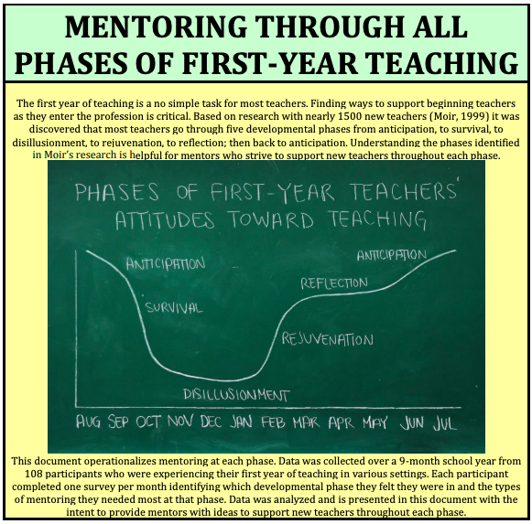

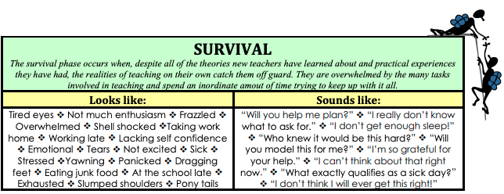
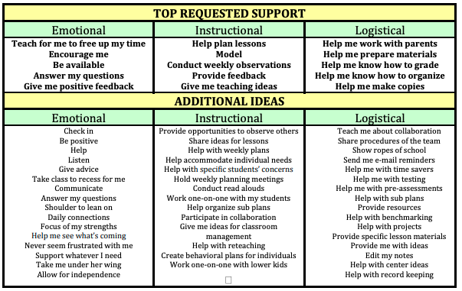
https://mentor.jordandistrict.org/wp-content/uploads/sites/17/MentoringBeginningTeachers.pdf

Slide 7

Tk20 DOCUMENTATION
Teacher Candidate
Mentor Teacher
Professors of Practice
Time log submitted weekly
Beginning of the year agreements
Dropbox
Lesson Plans
Self-reflection
Dispositions
Review/Approve forms
Electronic signatures and agreements
Two progress reports per semester
Dispositions and Final Evaluation
T-TESS POP cycle
Walkthroughs
Contact log
Dispositions and Final Evaluation
Tk20 is an online system used by teacher candidates, mentor teachers, and Professors of Practice to collect and analyze program data.
Tk20 Support: Tk20@shsu.edu
Login credentials are emailed to individual mentor teachers at the beginning of the semester.

Slide 8
SIMPLE TRUTHS ABOUT COACHING
Most people don’t know what it looks like when they do what they do.
People take it personally when we talk about their practice.
When we do the thinking for other people, they resist.
If people perceive us as putting ourselves as "one-up," they resist.
Unless people care about a goal, they aren't likely to achieve the goal.

Slide 9
THE COACHING CYCLE
Set a specific, attainable goal.
Teach / learn information for success with the goal.
Practice implementing the goal
Collect feedback about progress
Notes:
Mention they’ll gain access to a more detailed training for coaching.

Slide 10

WHAT MAKES A COACHING CYCLE SUCCESSFUL?
TRUST
COMMUNICATION
The teacher candidate must trust that the coach’s questions and comments within the coaching cycle are nonjudgemental and offered with the intention of helping the teacher candidate become a better teacher.
The coach must trust that the teacher candidate is making a sincere effort to learn and is willing to make observable changes to his/her behavior to achieve the goal.
The coach must be intentional about using communication tools that promote trust and risk-free thinking on the part of the teacher candidate.

Slide 11
KEYS TO SUCCESSFUL COACHING
TRUST
The relationship between the teacher candidate and coach must be trusting in that both parties are committed to taking risks and reflecting on the results with an eye toward learning.
COMMUNICATION
Communication skills are vital. The way questions are asked and information is shared can promote a productive conversation or shut one down.
GOALS
The goal must be bite-sized and observable.
COACHING CYCLE
The coaching cycle is ongoing and adaptable.
FEEDBACK
Feedback must be frequent and specific.

Slide 12
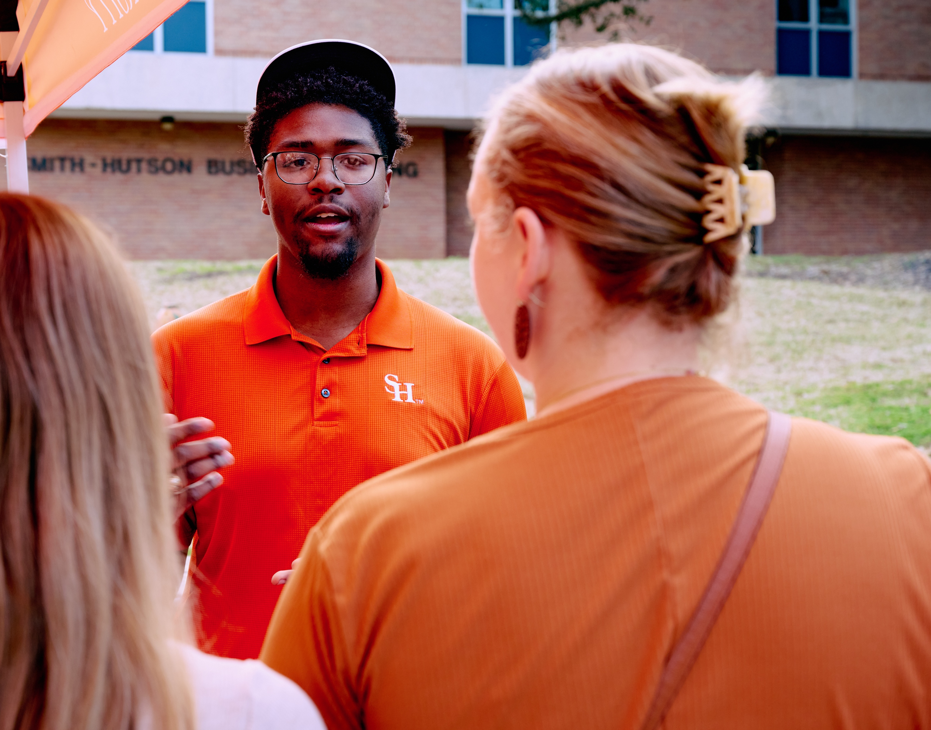

ROLE OF THE PROFESSOR OF PRACTICE
Conducts all performance assessments & walkthroughs
Provides ongoing feedback & coaching to the intern
Works with principals to support and evaluate the intern
Facilitates governance meetings with principals
Meets with mentor teachers during the semester to provide data and coaching support

Slide 13

T-TESS OBSERVATION FOR INTERN TEACHERS
T-TESS Observation – The evaluation process used at Sam Houston State University
Parts of a POP Cycle using the T-TESS rubric:
Pre-Conference to review the Intern’s lesson plan
Observation and scripting of the lesson by the Professor of Practice to gather evidence for evaluation
Post-Conference meeting with the Intern to review evidence, coach, and assign ratings. During the post-conference, the Professor of Practice will provide 1 area of Reinforcement and 1 area of Refinement
Notes:
3 formal observations (1 semester)
2 formal observations (2 semester)

Slide 14

PRIORITIES FOR THE JOURNEY AHEAD
Mentor teachers, interns, and Professors of Practice all play a critical and intertwined role in establishing a productive learning environment for intern teacher development
As the semester progresses, some key elements for all stakeholders to prioritize in maintaining the productive learning environment include:
Good communication
Opportunities for continual learning
Quality feedback accompanied by coaching toward goals

Slide 15

RESOURCES & DOCUMENTATION OF TRAINING COMPLETION
Visit the SHSU EPP resource page for Mentor Teachers to access information on the following resources:
TK20 – tk20@shsu.edu
SHSU 2025-2026 Guidelines for Clinical Experiences
Coaching Resources
Mentoring research and recommendations

Slide 16
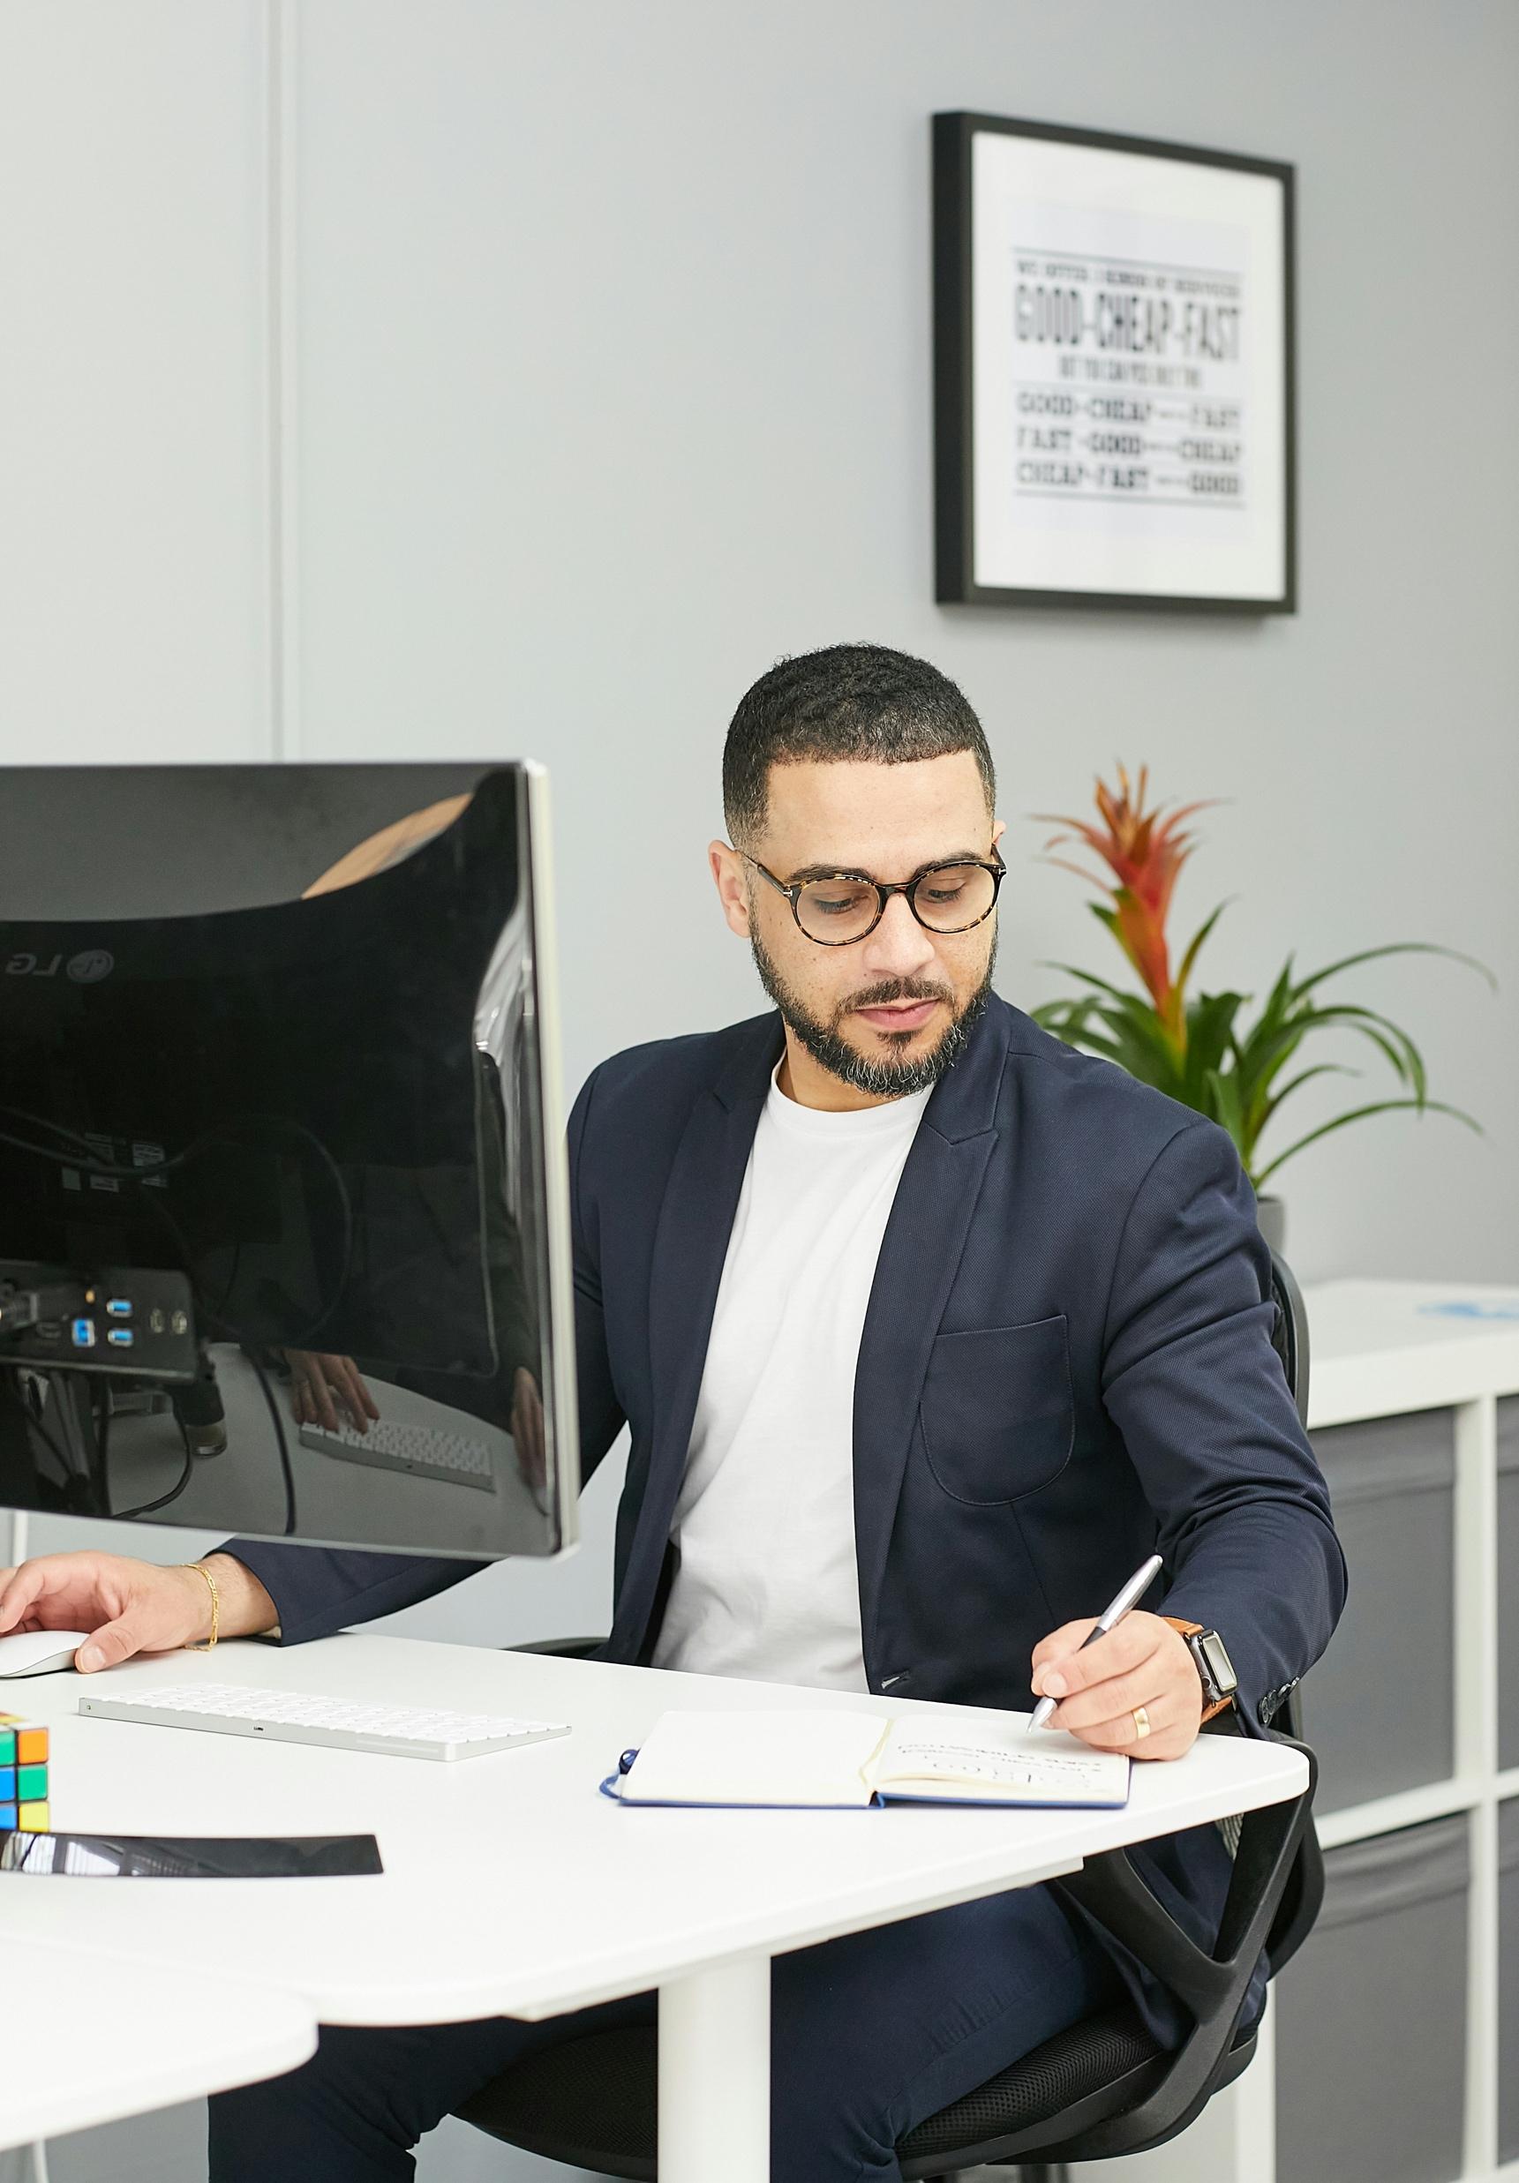
Verify Completion of Training
Don’t miss this Important Final Step!
Training Verification Link
Passkey: verifytrain

Slide 17
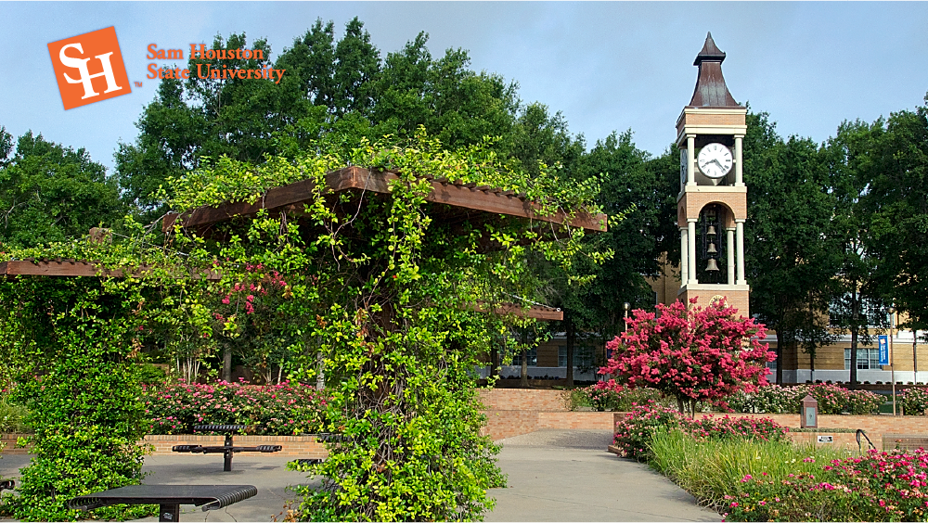
THANK YOU

