Slide 1





COOPERATING TEACHER ORIENTATION
CLINICAL TEACHING

Slide 2
OBJECTIVES
Explore
Understand
Emphasize
Explain
Explore the components of the SHSU Clinical Teaching Program and stakeholders involved
Understand the roles of the field supervisor and cooperating teacher in coaching the teacher candidate
Emphasize the co-teaching approaches and the coaching role to understand how they are used to help teacher candidates progress
Explain how data is analyzed to grow student teachers and the clinical teaching program
Explore
Explore the components of the SHSU Clinical Teaching Program and stakeholders involved
Understand
Understand the roles of the site coordinator and cooperating teacher in coaching the teacher candidate
Emphasize
Emphasize the co-teaching approaches and the coaching role to understand how they are used to help teacher candidates progress
Explain
Explain how data is analyzed to grow student teachers and the YCT program

Slide 3
KEY STAKEHOLDERS
The Faculty Member
The Teacher Candidate
The School Administrator
The Recruited & Trained Cooperating Teacher
The Field Supervisor
University Supervisor (SSCT)
Site Coordinator (YCT)

Slide 4
ROLE OF THE TEACHER CANDIDATE
YEARLONG CANDIDATE
SINGLE SEMESTER CANDIDATE
Year-long placement – 2 semesters
In the field 3 days SEM 1, 5 days SEM 2
Co-planning with Cooperating Teacher
Co-teaching with Cooperating Teacher
Works with cooperating teacher to follow the Progression of Student Teaching
Single semester placement
In the field 5 days for the semester
Co-planning with Cooperating Teacher
Co-teaching with Cooperating Teacher
Works with Cooperating Teacher to follow the Progression of Student Teaching

Slide 5
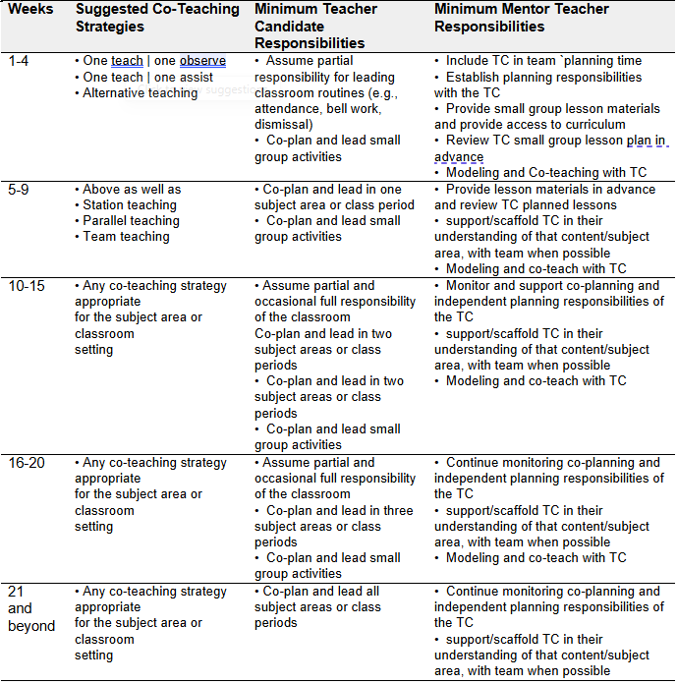
PROGRESSION OF STUDENT TEACHING
Notes:
Progression of teaching available in the SHSU Guidelines for Clinical Teaching for both SSCT and YCT.

Slide 6
BEGINNING EXPECTATIONS
The Teacher Candidate Should
Shadow the cooperating teacher and be engaged in listening and observing
Take notes and ask questions when appropriate
Be engaged in co-teaching from the very beginning
  One Teach, One Observe (watching the Cooperating Teacher for specific practices related to T-TESS)
  One Teach, One Assist (assisting the Cooperating Teacher with passing out materials, answering basic questions, supporting students)
  Alternative Teaching (helping a small group of students during a lesson)
  Station Teaching (planning station activities for a small group)

Slide 7

BENEFITS OF CO-TEACHING
…to Teacher Candidates
…to Cooperating Teachers
…to PK-12 Students
Enhanced collaboration skills
Enhanced classroom management skills
Seen as a “real” teacher
More teaching time
Deeper understanding of the curriculum and content through co-planning
Enhanced collaboration skills
Ability to reach more students, particularly those with high needs
Hosting a candidate without my students’ scores dropping
Enhanced energy for teaching
Daily opportunities for differentiation
Increased individualized attention and small group instruction
  More opportunities for student participation
  Increased student engagement
  More differentiation
Improved academic feedback
  Faster response to student questions
  Faster return of graded assignments
Improved student behavior
  More time on task; less “down time” for passing out papers, checking homework, attendance, etc.

Slide 8
CO-TEACHING STRATEGIES EXPLORATION
One Teach One Observe (click to watch)
Description:
One of the teachers has the primary responsibility for teaching, while the other teacher observes the lesson for specific data. The teachers analyze the data after the lesson. The teachers regularly switch roles.
When is this strategy most effective?
When observations are purposeful and structured focused on specific skills or behaviors.
When roles are switched regularly
When observational data/evidence is analyzed by both teachers and used to inform future instruction
Important Considerations:
Should be followed by specific coaching/next steps.
Include a switch in One Teach, One Observe to provide modeling and/or One Teach, One Assist to facilitate on-the-spot coaching and support.

Slide 9
CO-TEACHING STRATEGIES EXPLORATION
One Teach One Assist (click to watch)
Description:
One of the teachers has the primary responsibility for teaching, while the other teacher circulates around the room and supports students during the lesson
When is this strategy most effective?
At the beginning of a co-teaching relationship
When one teacher has a particular expertise
When the teachers regularly switch roles as the lead
For difficult processes that need closer student monitoring

Slide 10
CO-TEACHING STRATEGIES EXPLORATION
Team Teaching (click to watch)
Description:
Both teachers deliver instruction to the whole class. The teachers have equal roles in the lesson delivery.
When is this strategy most effective?
When both teachers have competence in the subject area
When the teachers equally present the content, interact, discuss and don’t just tag team
When planning time is shared
When both teachers trust each other and communicate well

Slide 11
CO-TEACHING STRATEGIES EXPLORATION
Station Teaching (click to watch)
Description:
The students and content are divided into groups or stations. Both teachers take responsibility for different stations. Stations can be facilitated, independent, or taught by a teacher.
When is this strategy most effective?
When both teachers take a role in planning their station(s)
When the teachers facilitate the small groups based on student needs
When students need to work at a varied pace
When there are skills that need to be practiced or reviewed

Slide 12
CO-TEACHING STRATEGIES EXPLORATION
Parallel Teaching (click to watch)
Description:
The students are divided into two groups. Each teacher is responsible for one of the groups and simultaneously teaches the same content.
When is this strategy most effective?
When students are divided carefully based on need
When the teachers have time to plan for simultaneous instruction
When a smaller student-to-teacher ratio is needed

Slide 13
CO-TEACHING STRATEGIES EXPLORATION
Alternative Teaching (click to watch)
Description:
One of the teachers has responsibility for teaching the whole class, while the other teacher instructs a small group to provide additional scaffolding, pre-teaching, or enrichment.
When is this strategy most effective?
When the small groups are used for a variety of purposes (not just re-teaching)
When the teachers switch roles—maximizing their expertise
When the small groups are planned based on student needs
Alternative teaching can be focused on the same content as the whole lesson or different content. The cooperating teacher or teacher candidate can instruct the alternative group.

Slide 14
ROLE OF THE COOPERATING TEACHER
1
2
3
Work collaboratively with the teacher candidate (TC) and field supervisor by attending informational meetings and communicating about the TC's process.
Co-plan, co-teach, and model instructional practices for the TC.
Collaborate with the TC to set targeted, weekly goals and share feedback about progress.
4
5
Schedule time to co-plan with the TC, ensuring the TC has time and resources to be successful.
Complete and review forms in TK20 for data collection and communication with the field supervisor

Slide 15
BEGINNING EXPECTATIONS
The Cooperating Teacher Should
Take opportunities to label and explain their thinking to build understanding of how teachers make decisions and navigate their role
Give guidance on the type of assistance needed from the teacher candidate for the co-teaching approaches
Incorporate opportunities for the teacher candidate to begin planning and teaching within the classroom according to the Progression of Student Teaching
Meet one-on-one with the teacher candidate to give feedback, coach, and plan for improvement
Provide explicit next steps and written feedback related to observations of instruction and professionalism that will help the teacher candidate learn and grow

Slide 16
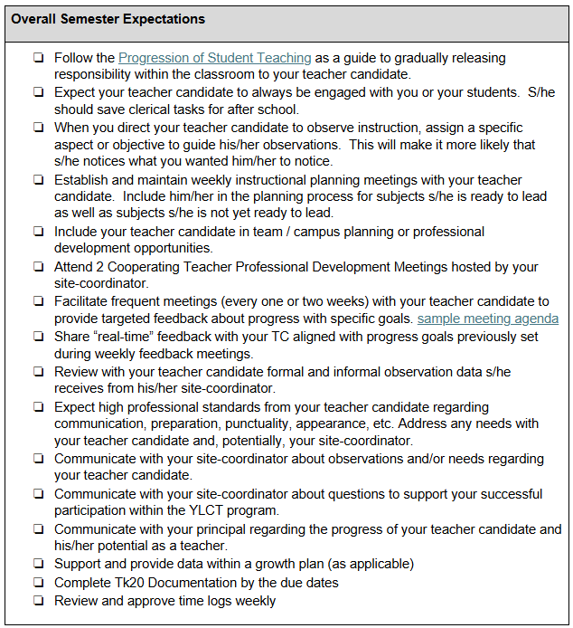
COOPERATING TEACHER TASKS AND TIMELINE
Notes:
Task and Timeline available for CT serving both SSCT and YCT.

Slide 17
Tk20 DOCUMENTATION
Teacher Candidate
Cooperating Teacher
Field Supervisor
Time log submitted to CT weekly
Beginning of the year agreements
Dropbox
Lesson Plans
Self-reflection
Dispositions
Review/Approve weekly time logs
Electronic signatures and agreements
Two progress reports per semester
Dispositions and Final Evaluation
T-TESS POP cycle
Walkthroughs
Contact log
Dispositions and Final Evaluation
Tk20 is an online system used by teacher candidates, cooperating teachers, and field supervisors to collect and analyze program data.
Tk20 Support: Tk20@shsu.edu
Login credentials are emailed to individual cooperating teachers at the beginning of the program.

Slide 18
SIMPLE TRUTHS ABOUT COACHING
Most people don’t know what it looks like when they do what they do.
People take it personally when we talk about their practice.
When we do the thinking for other people, they resist.
If people perceive us as putting ourselves as "one-up," they resist.
Unless people care about a goal, they aren't likely to achieve the goal.

Slide 19
THE COACHING CYCLE
Set a specific, attainable goal.
Teach / learn information for success with the goal.
Practice implementing the goal
Collect feedback about progress
Notes:
Mention they’ll gain access to a more detailed training for coaching.

Slide 20

WHAT MAKES A COACHING CYCLE SUCCESSFUL?
TRUST
COMMUNICATION
The teacher candidate must trust that the coach’s questions and comments within the coaching cycle are nonjudgemental and offered with the intention of helping the teacher candidate become a better teacher.
The coach must trust that the teacher candidate is making a sincere effort to learn and is willing to make observable changes to his/her behavior to achieve the goal.
The coach must be intentional about using communication tools that promote trust and risk-free thinking on the part of the teacher candidate.

Slide 21
KEYS TO SUCCESSFUL COACHING
TRUST
The relationship between the teacher candidate and coach must be trusting in that both parties are committed to taking risks and reflecting on the results with an eye toward learning.
COMMUNICATION
Communication skills are vital. The way questions are asked and information is shared can promote a productive conversation or shut one down.
GOALS
The goal must be bite-sized and observable.
COACHING CYCLE
The coaching cycle is ongoing and adaptable.
FEEDBACK
Feedback must be frequent and specific.

Slide 22


ROLE OF THE FIELD SUPERVISOR
Conducts all performance assessments & walkthroughs
Provides ongoing feedback & coaching to TC
Works with principals to carefully select and train the cooperating teachers
Teaches clinical teaching courses
For Yearlong Candidates:
  Facilitates quarterly governance meetings with principals
  Meets with cooperating teachers during the semester to provide data and coaching support

Slide 23
COOPERATING TEACHER AND FIELD SUPERVISOR COLLABORATION
Cooperating Teacher
Both
Field Supervisor
Co-Teaching
Co-Planning
Gradual release of responsibilities
Ongoing feedback to TC
Informal coaching
Document progress of TC in Tk20
Informal walkthrough observations
Formal T-TESS observations
Seminars
Notes:
Seminar = bridge theory to practice

Slide 24
T-TESS OBSERVATION FOR TEACHER CANDIDATES
T-TESS Observation – The evaluation process used at Sam Houston State University
Parts of a POP Cycle using the T-TESS rubric:
Pre-Conference to review the Teacher Candidate’s lesson
Observation and scripting of the lesson by the Field Supervisor to gather evidence for evaluation
Post-Conference meeting with the Teacher Candidate to review evidence, coach, and assign ratings. During the post-conference, the Field Supervisor provides 1 area of Reinforcement and 1 area of Refinement
T-TESS observations are video-captured by the field supervisors. Parental permission to appear in the video for each classroom student is needed or the student must be excluded from the video.
Cooperating teachers may watch the lesson and collect evidence related to the T-TESS rubric. Afterward, they will share their assessment of areas of strength and areas for growth with the field supervisor.
Notes:
SSCT = 3 formal observations (1 semester)
YCT = 4 formal observations (2 each semester)

Slide 25

PRIORITIES FOR THE JOURNEY AHEAD
Cooperating teachers, Teacher Candidates, and Field Supervisors all play a critical and intertwined role in establishing a productive learning environment for Teacher Candidate development
As the semester progresses, some key elements for all stakeholders to prioritize in maintaining the productive learning environment include:
Good communication
Opportunities for continual learning
Quality feedback accompanied by coaching toward goals

Slide 26

RESOURCES & DOCUMENTATION OF TRAINING COMPLETION
Visit the SHSU EPP resource page for Cooperating Teachers to access information on the following resources:
TK20 – tk20@shsu.edu
SHSU 2025-2026 Guidelines for Clinical Experiences
Coaching Resources
Co-Planning Guide
Co-Teaching Strategies
To receive credit for completing this required orientation, please complete the documentation below:
VERIFY TRAINING COMPLETION

Slide 27

THANK YOU

