Slide 1
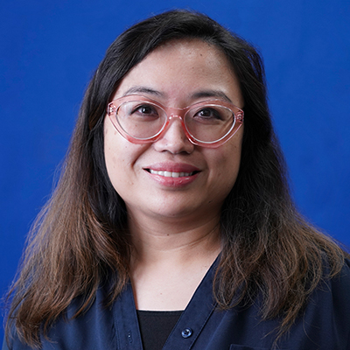

Field Experience Binders for Teacher Candidates
(updated August 2025)
Dr. Vivian Blackwell
DIRECTOR OF ACCREDITATION AND ACCOUNTABILITY SERVICES
Notes:
Vivian

Slide 2
A quick review of terminology
Field Experience Binder – this is the folder of forms that you need to complete during your clinical experience. It resides in Tk20.
SHSU Field Supervisor – this is your SHSU Field Supervisor or other faculty member that conducts walkthroughs and observations
Cooperating Teacher – this is your district-based mentor teacher
  Mentor teachers must log into Tk20 to complete field experience binder forms.
Timelogs – this is how you officially document your field hours.
  Mentor teachers do not log into Tk20 to approve timelogs, instead they are emailed a link from Tk20 after you submit your timelogs for approval (make sure there's no flag next to your timelogs).
  Make sure that you have entered your cooperating teacher's email address correctly.
  If their ISD email does not accept emails from Tk20 after repeated attempts (usually due to district firewalls), please ask your mentor teacher if there is another email address to which you can send your timelogs for approval.

Slide 3
The rule on whether or not to click "SUBMIT"
Field Experience Binders
  DO NOT SUBMIT - press SAVE every time.
TCAR
  SUBMIT - this is an assignment like any other that you must submit for a grade.
Timelogs
  SUBMIT – your timelogs cannot be approved unless they have been submitted for approval

Slide 4
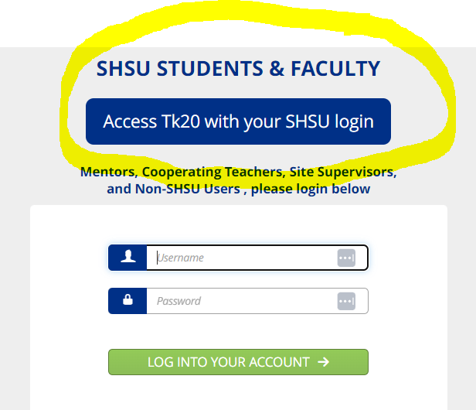
To access Tk20 -
Go to: https://tk20.shsu.edu/
Click the blue button

Slide 5
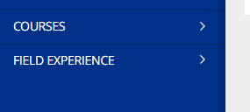
To access your field experience binder
Click on "Field Experience" in the menu on the left

Slide 6
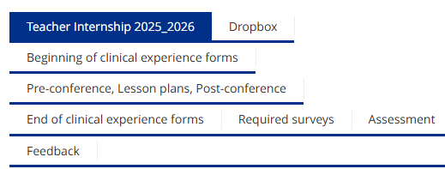
An overview of the tabs in your field experience binder

Slide 7
An overview of the tabs in your field experience binder (continued)
Dropbox – this is a place where you can attach forms such as absence notes as requested by your SHSU field supervisor
Beginning of Clinical Experience Forms – there are five forms for you to complete now at the beginning of your clinical experience
  Teacher Candidate Dispositions - Candidate Self-Assessment: 1
  FERPA Consent
  Standards of Professional Conduct
  Badge Policy
  Teacher Candidate Internship Handbook - Agreement and Electronic Signature

Slide 8
An overview of the tabs in your field experience binder (continued)
Pre-Conference, Lesson Plans, Post-Conference – these are part of the T-TESS POP cycle.
  The number of T-TESS observations that you complete this semester will be based on what pathway you are currently in
  For Teacher Candidates, please complete these forms
    Pre-Conference Lesson Plan and Questions: 1 (First semester)
    Pre-Conference Lesson Plan and Questions: 2 (First semester)
    Pre-Conference Lesson Plan and Questions: 3 (First semester)
    Pre-Conference Lesson Plan and Questions: 4 (Second semester)
    T-TESS Self-Reflection: 1 (First semester)
    T-TESS Self-Reflection: 2 (First semester)
    T-TESS Self-Reflection: 3 (First semester)
    T-TESS Self-Reflection: 4 (Second semester)

Slide 9
An overview of the tabs in your field experience binder (continued)
End of Clinical Experience Forms – complete these at the end of your clinical experience.
  Teacher Candidate Dispositions - Candidate Self-Assessment: 2
  Teacher Candidate Verification Form

Slide 10
An overview of the tabs in your field experience binder (continued)
Required Surveys – Your responses are confidential and are not shared with your field supervisor or cooperating teacher.
  Services and Operations Survey (complete at the end of your clinical experience)
  Survey of Field Supervisor (complete at the end of your clinical experience - one for each SHSU field supervisor)
  Survey of Cooperating/Mentor/Host Teacher (complete at the end of your clinical experience - one for each Cooperating Teacher)

Slide 11
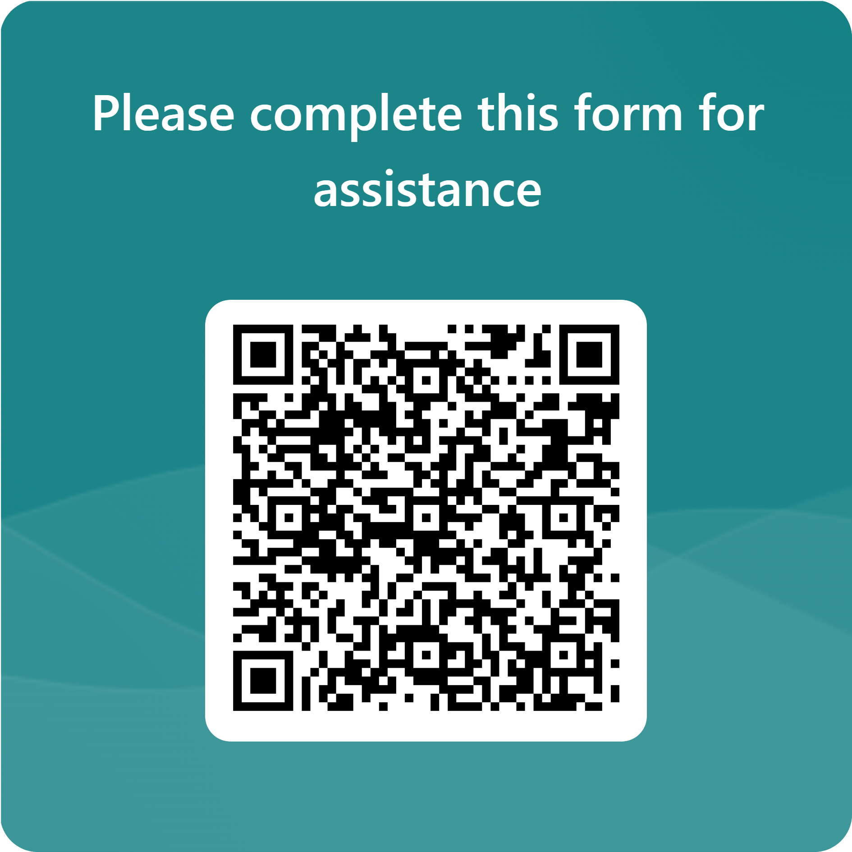
Need technical assistance with your field experience binder?
Please complete this form for assistance

